Slide 1


Workshop
Building Scalable Apps Featuring CockroachDB
v.0.0.4

Slide 2


Welcome! My name is
Sai.
[Put your Photo Here]
1
I’m here to lead this session & help you learn something new today!
2
I’m a Senior at Auburn.
3
My favorite programming language / tool is Python & Go / Docker.
Notes:
What to Edit:
Add your name, photo, school info, and favorite programming tool or language.
What to Do:
Make attendees feel welcome by running a short Ice Breaker.
Go around the room and ask each person to answer the following questions:
Who are you?
What year are you in school and what is your major/field of study?
What is your favorite programming language or tool?
You should go first to demonstrate the exercise and introduce yourself

Slide 3
Using your Web Browser,
Open this URL & Fill out the Form:
Afterwards, Check your Email to Find:
1
http://mlhlocal.host/checkin
2
Setup Instructions
An Invite to the MLH Slack
The Code Samples
A Workshop FAQ
These Workshop Slides
More Learning Resources
Notes:
What to Say:
Tell attendees we are going to check them in for the event
Once attendees check in, they will receive an email with the items listed on the slide (not always immediate)
Attendees must check in to get credit for attending this event
What to Do:
Confirm that everyone has checked in by asking participants to give you a signal when they receive the email.

Slide 4
What will you learn today?
1
What a database is & how the database you pick impacts your app’s ability to scale.
2
How to build a scalable web application using CockroachDB.
3
How to test your application’s ability to scale.
Notes:
What to Say:
Explain to participants what they will learn today
Learning is a core part of being a hacker and today they are going to learn something new
Note the participants should already be able to read code somewhat and have a basic understanding of what a command line shell does.
What to Do:
Get participants excited about the experience.

Slide 5
Why does this matter?
1
Successful apps need to grow without breaking/slowing. This is called scaling.
2
Scaling requires careful design of the stateful (data) part of your app.
3
Planning for scale helps you make better decisions earlier.
4
Employers want to hire engineers who can build for scale.
Notes:
What to Say:
Explain to participants why building scalable applications matters
Remind students that premature optimisation is a sin, but making room for later optimisation is a good.
The data part of your app can be considered the storage part. Alternatively, you can consider it seperate from the code used to display the data.
Learning to build for scale will make you a better hacker and employers want to hire people who can build for scale
What to Do:
Get participants excited about the experience.

Slide 6
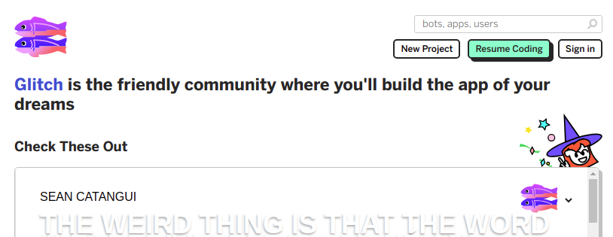
Let’s Set Up Glitch!
Sign in using GitHub or Facebook.
Note:
Making an account is not required, but your code will expire after 5 days if you don't.
Notes:
What to Say:
Glitch is a weird combination of a community and an online hosting service. They make it really easy to share and remix little projects.
Glitch lets you trade control for easy of sharing and setup.
What to Do:
Wait until everyone has signed in before continuing.

Slide 7
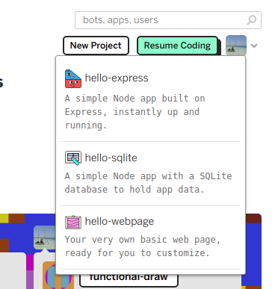
Let’s Set Up Glitch!
Create a new web page project and run it.
Notes:
What to Say:
We’re going to use glitch to host and build our app. Let’s start off with a basic web-page to get familiar with everything.

Slide 8
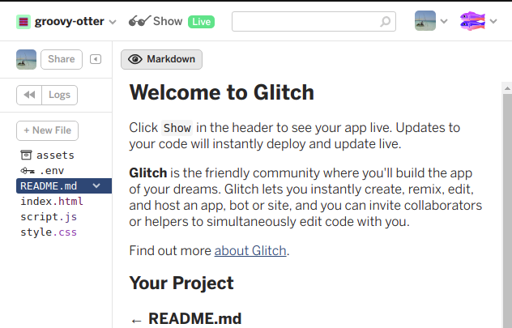
Let’s Set Up Glitch!
Show the output of the project
Notes:
What to Say:
Glitch live-updates your project. Let’s show the output of this current project.

Slide 9
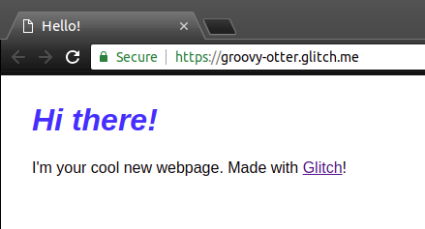
Let’s Set Up Glitch!
You should see something like this, but with a different URL
Notes:
What to Say:
That’s a web page! We’re going to do a more complicated page after we introduce databases.
What to Do:
Walk around making sure everyone has this web page.

Slide 11
Quiz!
WHEN DO YOU NEED A DATABASE?
Notes:
What to Say:
Major League Hacking (MLH) events are meant to bring hackers together so they can learn, build, and share.
Give participants a brief overview of Major League Hacking (MLH).
Tell participants they can learn more at http://mlh.io/
Example Talking Points:
TODO
Through Localhost MLH is rethinking technology education to reflect how hackers actually learn and how fast the industry moves.
Here’s some quick facts about MLH:
Each year, MLH supports over 65,000 hackers around the world at events they facilitate
Those students create more than 12,000 amazing projects together
MLH is a global organization that empowers hackers in more than 400 cities and growing every day

Slide 12
Local user settings on phone app
Case:
1
Formatted text file (JSON, CSV)
2
Lightweight database (SQLite or NoSQL)
3
Database (MySQL, PostgreSQL, CockroachDB)
Notes:
What to Say:
Read the slide, tell people to think and not answer for a few minutes.
Get people to raise their hand showing a number on their fingers to answer.
What to Do:
This is a really great time to gauge your audience’s comfort with databases. Given it’s often hard to read faces, their simultaneous answers will reveal how much they know and you can pace accordingly. If people are uncomfortable with raising their hands, reassure them this isn’t about judgement but helping them learn better. Everyone has to learn this stuff at some point.

Slide 13
Local user settings on phone app
Case:
1
Formatted text file (JSON, CSV)
2
Lightweight database (SQLite or NoSQL)
3
Database (MySQL, PostgreSQL, CockroachDB)
Notes:
What to Say:
Read the slide, tell people to think and not answer for a few minutes.
Get people to raise their hand showing a number on their fingers to answer.
What to Do:
This is a really great time to gauge your audience’s comfort with databases. Given it’s often hard to read faces, their simultaneous answers will reveal how much they know and you can pace accordingly. If people are uncomfortable with raising their hands, reassure them this isn’t about judgement but helping them learn better. Everyone has to learn this stuff at some point.

Slide 14
Music player phone app searchable collection browser
Case:
1
Formatted text file (JSON, CSV)
2
Lightweight database (SQLite or NoSQL)
3
Database (MySQL, PostgreSQL, CockroachDB)
Notes:
What to Say:
Read the slide, tell people to think and not answer for a few minutes.
Get people to raise their hand showing a number on their fingers to answer.
What to Do:
This is a really great time to gauge your audience’s comfort with databases. Given it’s often hard to read faces, their simultaneous answers will reveal how much they know and you can pace accordingly. If people are uncomfortable with raising their hands, reassure them this isn’t about judgement but helping them learn better. Everyone has to learn this stuff at some point.

Slide 15
Music player phone app searchable collection browser
Case:
1
Formatted text file (JSON, CSV)
2
Lightweight database (SQLite or NoSQL)
3
Database (MySQL, PostgreSQL, CockroachDB)
Notes:
What to Say:
Read the slide, tell people to think and not answer for a few minutes.
Get people to raise their hand showing a number on their fingers to answer.
What to Do:
This is a really great time to gauge your audience’s comfort with databases. Given it’s often hard to read faces, their simultaneous answers will reveal how much they know and you can pace accordingly. If people are uncomfortable with raising their hands, reassure them this isn’t about judgement but helping them learn better. Everyone has to learn this stuff at some point.

Slide 16
Online forum (Tumblr, Discourse)
Case:
1
Formatted text file (JSON, CSV)
2
Lightweight database (SQLite or NoSQL)
3
Database (MySQL, PostgreSQL, CockroachDB)
Notes:
What to Say:
Read the slide, tell people to think and not answer for a few minutes.
Get people to raise their hand showing a number on their fingers to answer.
What to Do:
This is a really great time to gauge your audience’s comfort with databases. Given it’s often hard to read faces, their simultaneous answers will reveal how much they know and you can pace accordingly. If people are uncomfortable with raising their hands, reassure them this isn’t about judgement but helping them learn better. Everyone has to learn this stuff at some point.

Slide 17
Online forum (Tumblr, Discourse)
Case:
1
Formatted text file (JSON, CSV)
2
Lightweight database (SQLite or NoSQL)
3
Database (MySQL, PostgreSQL, CockroachDB)
Notes:
What to Say:
Read the slide, tell people to think and not answer for a few minutes.
Get people to raise their hand showing a number on their fingers to answer.
What to Do:
This is a really great time to gauge your audience’s comfort with databases. Given it’s often hard to read faces, their simultaneous answers will reveal how much they know and you can pace accordingly. If people are uncomfortable with raising their hands, reassure them this isn’t about judgement but helping them learn better. Everyone has to learn this stuff at some point.

Slide 18

Database Basics
1
A database is an organized collection of data.
2
Data can be anything (numbers, text, files, etc.).
3
Databases allow web applications to have preserved state.
Notes:
What to Say:
Read the slide
Ask if participants have any prior experiences with databases
What to Do:
This is a really great time to gauge your audience’s comfort with databases - you’ll be able to see by the expressions on their faces if what you’re saying is familiar to them.

Slide 19
Database Management System (DBMS)
A Database Management System (DBMS) is software that lets you manage database structure and data.
Key Responsibilities
Querying: Processing commands to interact with the data.
Storage: Managing how the data is stored in the database.
Group Activity
Brainstorm: List out as many Database Management Systems as we can in 1 minute.
Hint: CockroachDB is one example!
Notes:
What to Say:
Tell participants that you’re going to take 2 minutes to list as many DBMSs as you can
What to Do:
Set a timer for 2 minutes and allow participants to call out their responses.

Slide 20




Four Types of Database Management Systems:
Relational Built for Consistency. Structured in tables. Example: | NoSQL Built for Scale (eventually). Unstructured. Example: | Key/Value Built for Speed. Unstructured Example: | NewSQL Scale & Consistency. Structured in Tables. Example:
Generally, you get either Consistency, Scale, or Speed.
NewSQL combines both Consistency & Scale.
Notes:
What to Say:
Relational databases represent and store data in tables and rows (think Excel)
There are four major types of NoSQL databases - document, graph stores, and wide-column stores. MongoDB is a popular document store database
Key/value databases, like redis, are the simplest variety of NoSQL database
The goal of NewSQL databases is to provide the best of both worlds - its structures data in tables, but scales like an NoSQL database
What to Do:
Make sure that you don’t lose anyone - invite questions and don’t go too fast

Slide 21
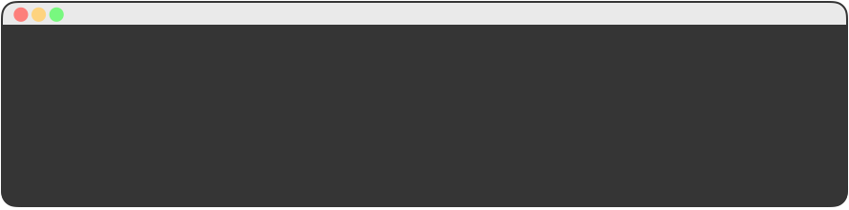
What are Relational Databases?
Data is structured into Tables (rows & columns).
Every row in a Table has the same columns.
Use “SQL” to query data.
ID | Hackathon | Date
1 | hackNY | 2017-04-08
2 | Hack Princeton | 2017-03-31
3 | HackBCA | 2017-03-25
4 | PearlHacks | 2017-02-11
/> SELECT * FROM my_database.hackathons WHERE Hackathon = “hackNY”;
+----+-----------+------------+
| id | Hackathon | Date |
+----+-----------+------------+
| 1 | hackNY | 2017-04-08 |
+----+-----------+------------+
Notes:
What to Say:
Relational databases might remind you of excel tables. That’s a great way to think of them.
What to Do:

Slide 22
What are NoSQL Databases?
Data is unstructured and is stored in Collections.
Every entry could have different columns.
Use “JSON” to query data.
Sample Collection:
{
“Hackathon”: “hackNY”,
“Date”: 2017-04-08
},
{
“Hackathon”: “Hack Princeton”,
“Date”: 2017-04-08,
“Custom-Data”: “Some Custom Data.”
}
/> db.hackathons.find({ Hackathon: “hackNY” })
{
“Hackathon”: “hackNY”,
“Date”: 2017-04-08
}
Notes:
What to Say:
Different NoSQL databases structure their data differently, as explained on a previous slide
JSON stands for JavaScript Object Notation. Although it is not actually JavaScript, it looks like the way an object is structured in JavaScript and is familiar to developers across many languages
The information in “Sample Collection” shows an example of JSON data
What to Do:

Slide 23
Both Relational & NoSQL DBs have Trade Offs.
Relational Database
Issues
Single-Server Databases are a point of failure.
Multi-Server Databases are complex (sharding).
NoSQL Database
Issues
Eventual Consistency is hard to deal with.
Databases can be out of sync and lose data.
Is there a way to get both scalability and consistency?
Yes, it’s called NewSQL!
Notes:
What to Say:
A point of failure means that a single server database can take down your entire application if it breaks or goes down
Multi-server databases shard (split data up) and this can occur unevenly or cause performance issues
Eventual consistency is an issue that occurs when information is distributed. Because information is distributed, not all parts of the database might have the most up to date information at the same time, which means the client might still have inaccurate information even after all the servers update
What to Do:
Remember not to move too fast, invite questions, and keep the energy up!

Slide 24
Meet NewSQL & CockroachDB.
What is NewSQL?
A new class of DBMS (started in 2011).
Scales like NoSQL.
Consistent like a Traditional Relational Database.
Created by Cockroach Labs in 2014.
Scalable SQL.
Survivable.
Consistent & Symmetric.
Notes:
What to Say:
NewSQL aims to avoid the pitfalls of relational and NoSQL databases
What to Do:

Slide 25
How does CockroachDB do this?
A CockroachDB deployment is
Composed of many Nodes (single instances of the database software).
Together they form a cluster (collection of nodes acting as a single database).
A CockroachDB Cluster:
Node 2
Node 1
Node 3
Notes:
What to Say:
An instance is a copy of a running program. Imagine having the same web page open in two tabs - you have two “instances” of that web page
A cluster is a group of instances of the software running together
Clustering instances is beneficial because it provides multiple, identical sources for retrieving the same data, meaning if one node goes down your application will still run
What to Do:
Remind the participants that this background information is useful, but not necessary to be able to do the workshop.

Slide 26
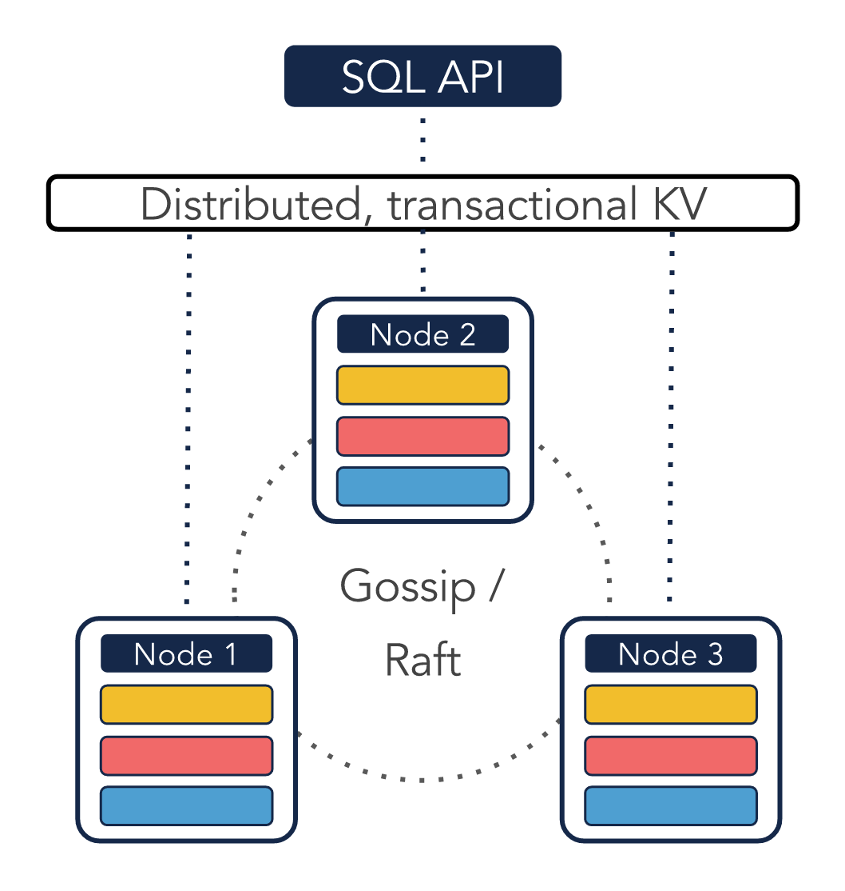
How does CockroachDB do this?
Under the hood, CockroachDB…
Splits your data into ranges, which are distributed across nodes in your cluster.
Replicates data across many nodes in your cluster in case one goes down.
Uses a peer-to-peer Gossip Protocol to organize Nodes and the RAFT Consensus Algorithm for consistency.
Notes:
What to Say:
Ranges are groups of data
The ranges are copied over on numerous clusters
A “gossip protocol” means each node tells another node the new data in pairs, so the number of nodes with new data continues to double (think about how rumors spread)
The RAFT consistency algorithm is complex but interesting - the important points to keep in mind are that the nodes will elect a “leader” that has the most up to date information, and the RAFT consistency algorithm: 1. Elects the leader 2. Handles how information is disseminated to “followers” 3. Makes sure that incorrect information is never surfaced (even if this means declining to resolve a request)
What to Do:
You can read more about the consensus algorithm here and here and here if you wish, but it’s not necessary

Slide 28
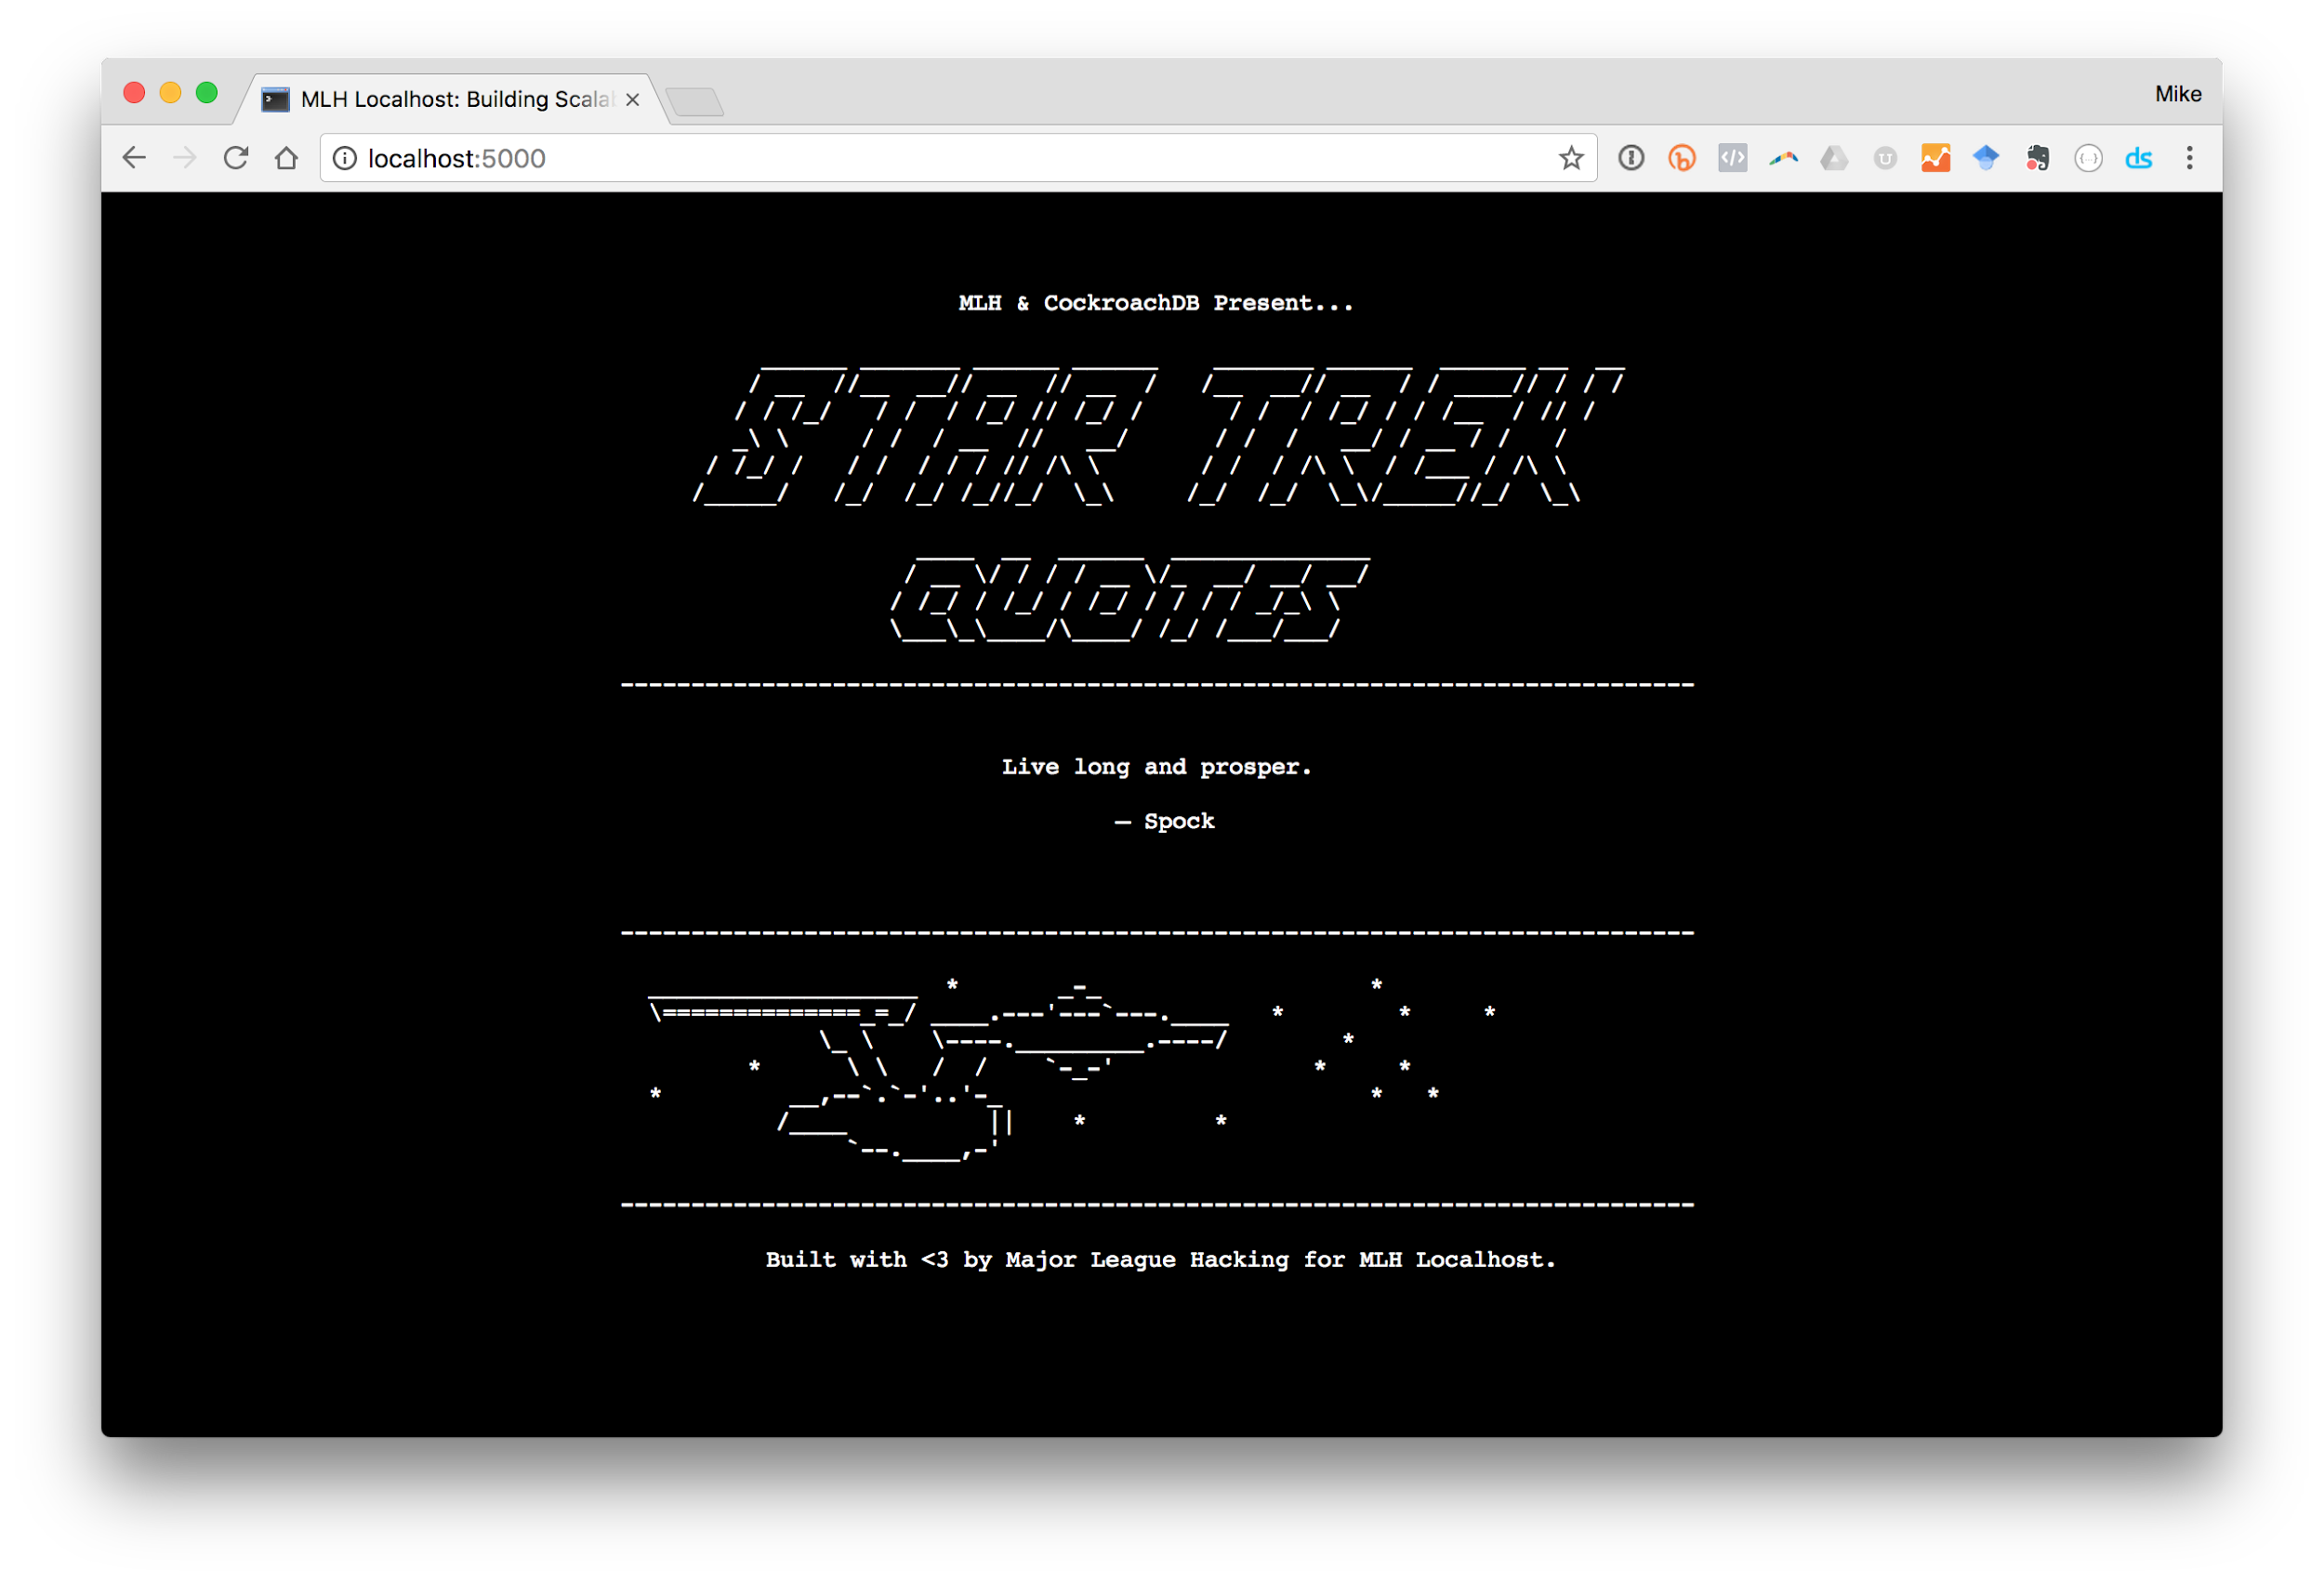
Try the Demo Application:
Goal:
Display a random Star Trek quote every 5 seconds.
Technologies:
Node.js
JavaScript
HTML / CSS
jQuery
https://local-hack-demo.glitch.me/
Notes:
What to Say:
At this url, you’ll be able to see a working version of the application that we’re going to interact with today
If you refresh the page a few times, you’ll see that the star trek quote changes every time
These quotes come from a CockroachDB database, which is super overkill, but still a useful example.
In this workshop, we’ll see how to interact with CockroachDB databases, but we won’t be writing any of the code for the sample program - we’ll just be familiarizing ourselves with it
What to Do:
Walk around and make sure everyone pulls up the website.

Slide 29
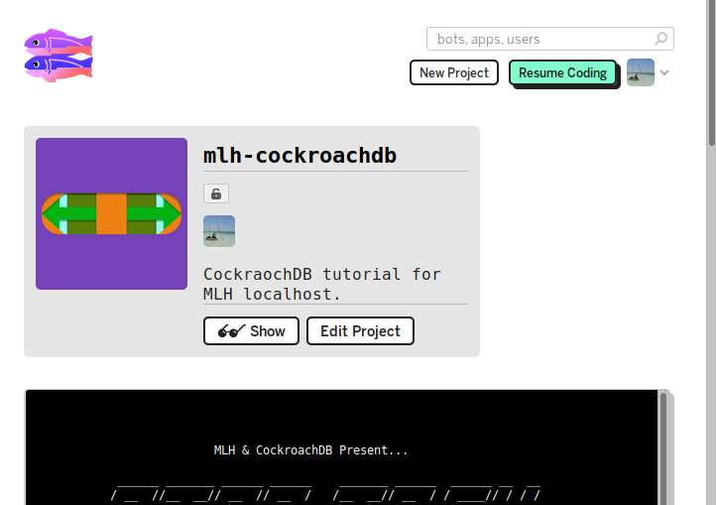
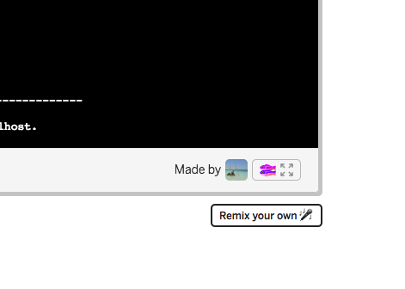
Make a copy of the demo
Remix the finished project at
https://auburnhacks.com/glitch
Scroll down past the preview.
Click Remix your own
Notes:
What to Say:
Glitch provides a console!
We’re going to get files and play with CockroachDB through this interface.
What to Do:
Walk around and make sure everyone was able to open a copy of the project.

Slide 30
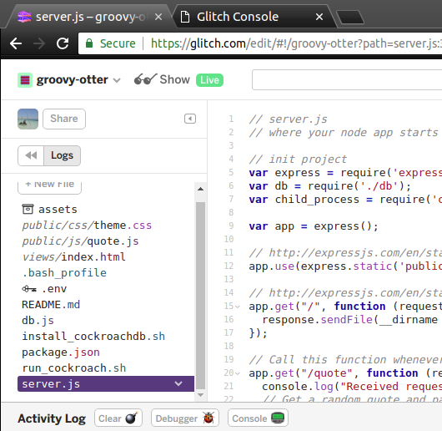
Run your copy of the demo
Notes:
What to Say:
Run the app. You should see a black and white interface, but with the message “BRB! Connecting to CockroachDB” instead of a working app.
We have to setup CockroachDB!
What to Do:
Walk around and make sure everyone found the “show” button.

Slide 31
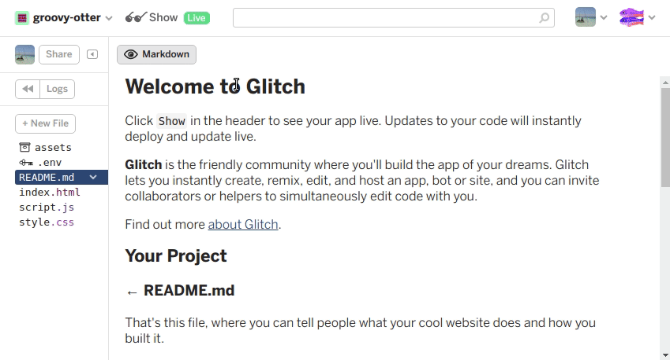
Open the Project Console
Click Logs -> Console
This will open the console in a new tab.
Notes:
What to Say:
Glitch provides a console!
We’re going to get files and play with CockroachDB through this interface.
What to Do:
Walk around and make sure everyone found the console.

Slide 32


File Browser vs. Console
Different views of the same thing
File Browser
Click things to select files and navigate
Type things into the files
Console
Type commands to perform actions and navigate
Needs to be synced with File Browser with refresh command
Keep both these tabs open at all times.
Notes:
What to Say:
A console is like a old-school interface to a computer. The usual clicking actions are replaced with typing. All typing all the time.
Console interfaces are easier to program and sometimes you can do things more easily in a console than by clicking.
What to Do:
Reassure people they will be helped through the scary console interface. We’re only going to be running simple commands.

Slide 33
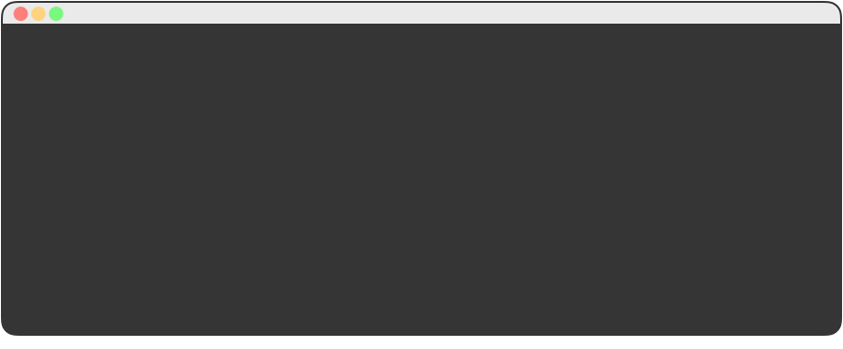
Install CockroachDB
Run a series of commands for installation saved inside install_cockroachdb.sh using the sh command
$ source install_cockroachdb.sh
Installing CockroachDB
--2018-06-28 19:00:03-- https://binaries.cockroachdb.com/cockroach-latest.linux-amd64.tgz
...
Notes:
What to Say:
This file holds a bunch of commands which are annoying to explain. You can open the file and read them if you’re really keen. The effect of running this script is installing CockroachDB.

Slide 34
Make sure CockroachDB is working.
To test that your installation was successful, type the command below in your Terminal.
$ cockroach version
Build Tag: v2.0.3
Build Time: 2018/06/18 16:11:33
Distribution: CCL
Platform: linux amd64 (x86_64-unknown-linux-gnu)
Go Version: go1.10
C Compiler: gcc 6.3.0
Build SHA-1: 91715a9a95edbe716912173204fa4c0fc6724457
Build Type: release
Notes:
What to Say:
We are going to check if we got cockroach working! Type the command
This will let us see which version of Cockroach we have running
If you close your shell at this point, you'll lose access to cockroach and will have to run the final command from install_cockroach.sh again
What to Do:
Provide assistance to any students who do not get the correct response

Slide 35
Start your first instance of CockroachDB!
To launch your first Cluster with one Node, run the following command in the terminal. DON’T CLOSE THE TERMINAL FROM NOW ON!
$ cd ~/.data
$ cockroach start --insecure --host=localhost --background
* WARNING: RUNNING IN INSECURE MODE!
*
* - Your cluster is open for any client that can access localhost.
* - Any user, even root, can log in without providing a password.
* - Any user, connecting as root, can read or write any data in your cluster.
* - There is no network encryption nor authentication, and thus no confidentiality.
*
* Check out how to secure your cluster: https://www.cockroachlabs.com/docs/stable/secure-a-cluster.html
*
CockroachDB node starting at 2017-11-02 18:06:21.541283 +0000 UTC (took 0.4s)
build: CCL v1.1.2 @ 2017/11/02 20:52:23 (go1.9.2)
admin: http://localhost:8080
sql: postgresql://root@localhost:26257?application_name=cockroach&sslmode=disable
logs: /Users/majorleaguehacking/cockroach-data/logs
...
Notes:
What to Say:
Do these commands in the .data directory so it doesn’t add junk to your code directory
The command that you’re typing does the following things:
cockroach start starts a new node (an instance of cockroach)
--insecure allows any user to access this database and change it
--host=localhost sets “localhost” as the hostname to listen on. Localhost means that the website is being hosted on the computer you’re currently using. This flag is telling the application that the website is on your machine, rather than a remote server somewhere else.
--background sets the node to start in the background, which means to keep it running for when you need it
You can read more about these flags and others in the Cockroach documentation.
Closing the terminal sometimes kills all running processes. So if you close it, you’ll have to restart all your cockroach nodes. It isn’t tragic, just annoying. To be safe, save the commands you’re running in a .sh file.
What to Do:
Continue making sure that everyone is ready to move on before you go to the next slide.

Slide 36
Let’s create the sample data.
Run the following command to create a database named startrek which contains quotes & episode tables.
$ cockroach gen example-data startrek | cockroach sql --insecure
CREATE DATABASE
Time: 505.928737ms
SET
Time: 1.582383ms
DROP TABLE
Time: 2.200558ms
CREATE TABLE
Time: 538.467864ms
INSERT 1
Time: 968.790375ms
INSERT 1
Time: 220.132547ms
INSERT 1
Time: 792.940707ms
...
Notes:
What to Say:
cockroach gen example-data generates example data
The | (called a pipe) says we will take the output from the command on the left and use it as inputs to the command on the right. This means we take the example data generated and use it for the next command.
cockroach sql --insecure enters the SQL shell so that we can query the database
Note that the “startrek” database is an example database provided by CockroachDB and includes two tables - episodes and quotes
What to Do:
Make sure everyone gets the same response. Encourage participants to work together if they’re stuck.

Slide 37
Use the Command Line to see your Data.
When you run the command bellow, CockroachDB will place you in an program that responds to SQL Queries.
$ cockroach sql --insecure
# Welcome to the cockroach SQL interface.
# All statements must be terminated by a semicolon.
# To exit: CTRL + D.
root@:26257/>
Notes:
What to Say:
cockroach sql --insecure enters the SQL shell so that we can query the database
Now that we are in our database, both systems will be able to write the same commands
What to Do:
Continue checking the energy and inviting questions.

Slide 38
List the available databases.
You can see a list of available databases using
the SHOW DATABASES; Command.
root@:26257/> SHOW DATABASES;
+--------------------+
| Database |
+--------------------+
| crdb_internal |
| information_schema |
| pg_catalog |
| startrek |
| system |
+--------------------+
(5 rows)
root@:26257/>
Notes:
What to Say:
This command shows all of the databases you have in your system
What to Do:

Slide 39
What’s inside the startrek database?
The Command we ran earlier created the startrek database. See what’s inside with SHOW TABLES.
root@:26257/> SHOW TABLES FROM startrek;
+----------+
| Table |
+----------+
| episodes |
| quotes |
+----------+
(2 rows)
root@:26257/>
Notes:
What to Say:
Let’s check out startrek database and see what tables are inside of it using the command above.
There are two tables in the startrek database - one with a list of episodes and one with quotes
What to Do:

Slide 40
What’s inside the startrek database?
The Command we ran earlier created the startrek database. See what’s inside with SHOW TABLES.
root@:26257/> SELECT * FROM startrek.episodes;
+----+--------+-----+----------------------------------------------------+----------+
| id | season | num | title | stardate |
+----+--------+-----+----------------------------------------------------+----------+
| 1 | 1 | 1 | The Man Trap | 1531.1 |
| 2 | 1 | 2 | Charlie X | 1533.6 |
| 3 | 1 | 3 | Where No Man Has Gone Before | 1312.4 |
| 4 | 1 | 4 | The Naked Time | 1704.2
| 5 | 1 | 5 | The Enemy Within | 1672.1 |
| 6 | 1 | 6 | Mudd's Women | 1329.8 |
| 7 | 1 | 7 | What Are Little Girls Made Of? | 2712.4 |
| 8 | 1 | 8 | Miri | 2713.5 |
| 9 | 1 | 9 | Dagger of the Mind | 2715.1 |
| 10 | 1 | 10 | The Corbomite Maneuver | 1512.2 |
. . . .
(79 rows)
root@:26257/>
Notes:
What to Say:
If we want to see what the episodes table from startrek contains, we can print it with the command above
See if you can figure out how to see what quotes startrek contains
(Answer: SELECT * FROM startrek.quotes;)
What to Do:

Slide 41
How would we get a random startrek quote?
This is what you would write in SQL:
SELECT * FROM startrek.quotes ORDER BY RANDOM() LIMIT 1;
Read all
Columns
From the quotes Table
in the startrek Database
Order the results randomly
Limit the results to one
Notes:
What to Say:
How do you think this code relates to the web page we previewed a little while ago?
What to Do:
This is a good time to make sure everyone is on the same page or to pause for catch up.

Slide 42
Get a random startrek quote.
Let’s get a random quote from the startrek quotes table using the query we just wrote.
root@:26257/> SELECT * FROM startrek.quotes ORDER BY RANDOM() LIMIT 1;
+-------------------+------------+----------+---------+
| quote | characters | stardate | episode |
+-------------------+------------+----------+---------+
| You're dead, Jim. | McCoy | 3372.7 | 30 |
+-------------------+------------+----------+---------+
(1 rows)
root@:26257/>
Notes:
What to Say:
Let hackers know they will get different quotes - “random”
What to Do:
Verify that everyone is getting this response but potentially with different quotations.

Slide 43
How do you exit the SQL shell?
We’re done with the SQL shell. Quit and return to your normal terminal by using \q.
root@:26257/> \q
$
Notes:
What to Say:
Read the slide.
What to Do:

Slide 44
Let’s explore the application code!
In the file tree on the left side of the file browser tab, click server.js.
Notes:
What to Say:
Read the slide.
What to Do:
Ask if anyone has any questions.

Slide 45
What does this application do?
Lines 5 - 17 and 31 - 37 cover the server boilerplate code.
All this app does is serve static files (like HTML).
server.js
// load libraries var express = require('express'); var db = require('./db'); var child_process = require('child_process') // Use Express to serve files from the /public directory // http://expressjs.com/en/starter/static-files.html var app = express(); app.use(express.static('public')); // http://expressjs.com/en/starter/basic-routing.html app.get("/", function (request, response) { response.sendFile(__dirname + '/views/index.html'); });
Notes:
What to Say:
Lines 5 - 17 and 31 - 37 are used for us building our basic web application. From here we will want to add code so we can get a random quote each time.
The last line is commented out, because we don’t want to run the server to run automatically yet. Also, we’re already running it in the console.
What to Do:

Slide 46
How do we return quotes?
Whenever someone visits the demo website,
we run the following code to return a random quote.
server.js
11 // Call this function whenever someone requests the /quote path
12 app.get('/quote', function(req, res) {
13 // Get a random quote and pass it to the browser.
14 client.query('SELECT * FROM quotes ORDER BY RANDOM() LIMIT 1')
15 .then(data => res.send(data.rows[0]))
16 .catch(err => res.send({ error: "BRB! Connecting to CockroachDB" }))
17 })
Notes:
What to Say:
Here we are adding a new route for us to hit. Whenever someone goes to localhost:8080/quote, this is the code that runs on our backend.
It makes our query to the backend to get a random quote. If it is successful, the server sends back the data from our given row. If it isn’t the server sends back the error message “BRB! Connecting to CockroachDB”
What to Do:
s

Slide 47
Next, let’s see how we connect to CockroachDB in db.js
Open db.js
db.js
01 // Connect to the startrek Database on a node in our CockroachDB cluster
02 var pg = require('pg');
03 var config = { user: 'root', database: 'startrek', port: 26257 };
04 var db = new pg.Pool(config);
05
06 // Log when we connect to the CockroachDB node
07 db.on('connect', function(client) { console.log("Connected to CockroachDB.") })
08
09 // Log any errors we encounter
10 db.on('error', function(e) { console.error("Err connecting to CockroachDB.") })
11
12 // Export the database connection so anyone can use it
13 module.exports = db;
Notes:
What to Say:
Line 2 requires ‘postgres’, a SQL client that allows us to interact with our database
Line 3 tells the program which database we’re going to access
Line 7 says to log “Connected to CockroachDB” when a successful connection is established with the database
Line 10 says to log “Err connecting to CockroachDB.” if you are unable to connect for some reason
module.exports = db allows the code we’ve written here to be used by other files - notice that line 3 of server.js is requiring the code from this file!
What to Do:
Ask if anyone has questions

Slide 48
Run the application.
Click the Show button in your Glitch file browser tab as before.
Notes:
What to Say:
Refresh the page a few times if you don’t want to wait 5 seconds for the quote to refresh.
Look at your log in the main Glitch window - notice that “Connected to CockroachDB.” was logged in your Glitch file-browser window after the Star Trek Quotes web page loaded in your browser
What to Do:
Make sure that everyone gets this working before you move on.
If it’s not working for someone, go through their command history and consult the debugging guide in the README

Slide 50
Let’s add a 2nd Node to our Cluster.
To add another node, we need to tell it which cluster to join and specify an open set of ports.
$ cockroach start --insecure --host=localhost --background --join=localhost:26257
--store=mlh-node2 --port=26258 --http-port=8081
*
* WARNING: RUNNING IN INSECURE MODE!
// More Warnings
*
CockroachDB node starting at 2017-11-02 18:26:28.771325 +0000 UTC (took 1.2s)
build: CCL v1.1.0 @ 2017/10/18 08:14:16 (go1.9.1)
admin: http://localhost:8081
sql: postgresql://root@localhost:26258?application_name=cockroach&sslmode=disable
logs: /Users/majorleaguehacking/Downloads/mlh-localhost-cockroachdb-master/mlh-node2/logs
...
Notes:
What to Say:
To create a new node, we use the same code from before - cockroach start --insecure --host=localhost --background - and we add some more flags
--join=localhost:26257 means that the new node should work with our existing node
--store=mlh-node2 is how we name the new node
--port=26258 and --http=port=8081 set the location of the of the new node to be on a different port than the existing node.
Keep adding these commands to a .sh file
Everything after this is going to happen a little more slowly, because CockroachDB uses a lot of resources and a Glitch instance has very few resources.
What to Do:
Make sure everyone gets this working before you move on.

Slide 51
And a 3rd Node.
Just change “node2” to “node3” and increment the ports by one. Make sure the cluster stays the same though.
$ cockroach start --insecure --host=localhost --background --join=localhost:26257
--store=mlh-node3 --port=26259 --http-port=8082
*
* WARNING: RUNNING IN INSECURE MODE!
*
// More Warnings
CockroachDB node starting at 2017-11-02 18:28:15.597333 +0000 UTC (took 1.2s)
build: CCL v1.1.0 @ 2017/10/18 08:14:16 (go1.9.1)
admin: http://localhost:8082
sql: postgresql://root@localhost:26259?application_name=cockroach&sslmode=disable
logs: /Users/majorleaguehacking/Downloads/mlh-localhost-cockroachdb-master/mlh-node3/logs
...
Notes:
What to Say:
Notice that each time we increase the node number, port number, and http-port number by 1
Add this command to a .sh file
Everything we’ve done so far is in the run_cockroach.sh file.
What to Do:
Ask if anyone has any questions.

Slide 52
You should see 3 Nodes listed.
$ cockroach node ls --insecure
+----+
| id |
+----+
| 1 |
| 2 |
| 3 |
+----+
(3 rows)
$ cockroach node status --insecure
+----+-----------------+--------+---------------------+---------------------+---------+
| id | address | build | updated_at | started_at | is_live |
+----+-----------------+--------+---------------------+---------------------+---------+
| 1 | localhost:26257 | v2.0.3 | 2018-06-19 16:39:33 | 2018-06-19 16:31:13 | true |
| 2 | localhost:26258 | v2.0.3 | 2018-06-19 16:39:33 | 2018-06-19 16:35:43 | true |
| 3 | localhost:26259 | v2.0.3 | 2018-06-19 16:39:31 | 2018-06-19 16:37:01 | true |
+----+-----------------+--------+---------------------+---------------------+---------+
Notes:
What to Say:
Note the return of the command ls
What to Do:
Try not to move too quickly! The goal of this workshop isn’t to make it through all the material, but to get people to understand some core concepts.

Slide 53
What about Fault Tolerance?
Let’s take one of our nodes offline, change some data while it’s down, and see what happens!
$ cockroach quit --insecure --port=26258
ok
Notes:
What to Say:
Fault Tolerance means ability to continue when bad things happen, like something breaking
The code above basically “shuts down” the node at localhost:26258 (one of the three that we’ve created during this workshop)
This is simulating an actual fault, like a server going down, because ideally you would have one cockroachdb node per server
What to Do:

Slide 54
What do you see when the Node is down?
Notice anything?
$ cockroach node status --insecure
+----+-----------------+--------+---------------------+---------------------+---------+
| id | address | build | updated_at | started_at | is_live |
+----+-----------------+--------+---------------------+---------------------+---------+
| 1 | localhost:26257 | v2.0.3 | 2018-06-19 16:52:23 | 2018-06-19 16:31:13 | true |
| 2 | localhost:26258 | v2.0.3 | 2018-06-19 16:49:33 | 2018-06-19 16:35:43 | false|
| 3 | localhost:26259 | v2.0.3 | 2018-06-19 16:52:21 | 2018-06-19 16:37:01 | true |
+----+-----------------+--------+---------------------+---------------------+---------+
Notes:
What to Say:
The specific node you take down will be less recently updated and is_live will be marked as false
What to Do:
Make sure that everyone is in the same place as you.

Slide 55
What do you see when the Node is down?
The previous command took down Node 2.
$ cockroach node status --insecure
+----+-----------------+--------+---------------------+---------------------+---------+
| id | address | build | updated_at | started_at | is_live |
+----+-----------------+--------+---------------------+---------------------+---------+
| 1 | localhost:26257 | v2.0.3 | 2018-06-19 16:52:23 | 2018-06-19 16:31:13 | true |
| 2 | localhost:26258 | v2.0.3 | 2018-06-19 16:49:33 | 2018-06-19 16:35:43 | false|
| 3 | localhost:26259 | v2.0.3 | 2018-06-19 16:52:21 | 2018-06-19 16:37:01 | true |
+----+-----------------+--------+---------------------+---------------------+---------+
Notes:
What to Say:
The specific node you take down will be less recently updated and is_live will be marked as false
What to Do:
Make sure that everyone is in the same place as you.

Slide 56
Let’s write some data to your Cluster.
This time, let’s write to Node #3 by specifying a port.
In the example, we’re going to change some data.
$ cockroach sql --insecure --port=26259
# Welcome to the cockroach SQL interface.
# All statements must be terminated by a semicolon.
# To exit: CTRL + D.
#
# Server version: CockroachDB CCL v1.1.0 (darwin amd64, built 2017/10/18 08:14:16, go1.9.1) (same version as client)
# Cluster ID: 41b2e624-ce49-40fa-8ef3-e573f4dda3bb
#
# Enter \? for a brief introduction.
#
root@:26259/> SET sql_safe_updates = false;
root@:26259/> UPDATE startrek.quotes SET characters = 'your_name_here';
UPDATE 200
root@:26259/> \q
Notes:
What to Say:
Make sure to replace “your_name_here” with your actual name
Update 200 is the success message - there are 200 quotes that have been updated with your name!
What to Do:
Make sure that everyone has completed this step before moving on.
Notes to Speaker:
Be sure to everyone uses ‘ (single quotes); You may get a “column name “your_name_here” not found” error and you can resolve that with making sure to use single quotes

Slide 57
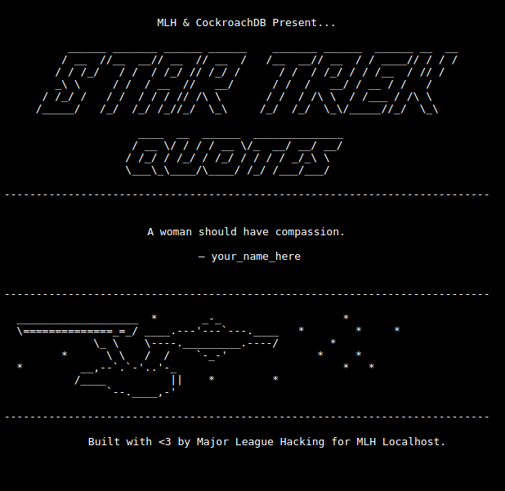
To see if it worked, refresh your App.
Notes:
What to Say:
Nothing should have changed from before except the name
What to Do:
Ask if everyone gets it working.

Slide 58
Let’s bring our Node back online.
We can just reuse the same command we used to start the node in the first place.
$ cockroach start --insecure --host=localhost --background --join=localhost:26257
--store=mlh-node2 --port=26258 --http-port=8081
*
* WARNING: RUNNING IN INSECURE MODE!
*
// More Warnings
CockroachDB node starting at 2017-11-02 18:42:09.9441 +0000 UTC (took 2.2s)
build: CCL v1.1.0 @ 2017/10/18 08:14:16 (go1.9.1)
admin: http://localhost:8081
sql: postgresql://root@localhost:26258?application_name=cockroach&sslmode=disable
...
Notes:
What to Say:
This restarts the node we took down
What to Do:
Go around and help troubleshoot for participants who didn’t get the desired outcome.

Slide 59
Let’s connect & see what data it has...
Connect to the SQL console on the Node you just brought back online. What data does it have?
$ cockroach sql --insecure --port=26258
# Welcome to the cockroach SQL interface.
# All statements must be terminated by a semicolon.
# To exit: CTRL + D.
root@:26258/> SELECT * FROM startrek.quotes ORDER BY RANDOM() LIMIT 1;
+---------------------------------------+----------------+----------+---------+
| quote | characters | stardate | episode |
+---------------------------------------+----------------+----------+---------+
| We have phasers, I vote we blast 'em! | your_name_here | 1514.2 | 10 |
+---------------------------------------+----------------+----------+---------+
root@:26258/> \q
Notes:
What to Say:
Notice that this node has your name as the character instead of the actual character from the show
What to Do:
Make sure everyone is keeping up.

Slide 60
Let’s connect & see what data it has...
Pay close attention below - we have changed the port from 26258 to 26257.
$ cockroach sql --insecure --port=26257
# Welcome to the cockroach SQL interface.
# All statements must be terminated by a semicolon.
# To exit: CTRL + D.
root@:26258/> SELECT * FROM startrek.quotes ORDER BY RANDOM() LIMIT 1;
+---------------------------------------+----------------+----------+---------+
| quote | characters | stardate | episode |
+---------------------------------------+----------------+----------+---------+
| We have phasers, I vote we blast 'em! | your_name_here | 1514.2 | 10 |
+---------------------------------------+----------------+----------+---------+
root@:26258/> \q
Notes:
What to Say:
Now we’re looking one of the nodes we didn’t take down or update. Notice that it has your name for all the characters as well. This data was replicated once mlh-node2 came back online.
What to Do:

Slide 62
Let’s recap quickly...
1
It was simple to connect CockroachDB to our application using an existing library.
2
CockroachDB split & replicated our data across multiple Nodes in our Cluster.
3
When a Node came back online, it worked with the other Nodes to catch up on what it missed.
Notes:
What to Say:
What to Do:

Slide 63
What did you learn today?
We created a fun quiz to test your knowledge and see what you learned from this workshop.
http://mlhlocal.host/quiz
Notes:
What to Say:
What to Do:

Slide 65
Join the CockroachDB community today:
1
Read the Documentation: http://mlhlocal.host/cockroach-docs
2
Post Questions on StackOverflow: http://mlhlocal.host/cockroach-stackoverflow
3
Use with CockroachDB in your favorite language: http://mlhlocal.host/cockroach-build
Notes:
What to Say:
What to Do:

Slide 66
Keep Learning: Practice Problems for later.
#1: Advanced SQL
#2: Deploy on AWS
Challenge: Display the episode name next to the quote in your application.
Instructions: Perform a JOIN between the quotes and episodes tables to get the episode title.
Challenge: Deploy your application on AWS and use HAProxy to load balance.
Instructions: Make your application production ready by deploying on 4 AWS micro instances with HAProxy.
Notes:
What to Say:
What to Do:

Slide 67

Learning shouldn’t stop when the workshop ends...
Check your email for access to:
These workshop slides
Practice problems to keep learning
Deeper dives into key topics
Instructions to join the community
More opportunities from MLH!
Notes:
What to Say:
What to Do:

Slide 68


Sign up for the MLH Career Lab!
http://mlhlocal.host/career-lab
Browse a curated list of hacker jobs.
Apply for jobs and internships from companies that want to recruit directly from the MLH community.
Receive updates and career advice from MLH!
Notes:
What to Say:
If you didn't opt into the career lab on the check-in survey, you can go to the url above and sign up any time you wish!

Slide 69
Workshop
Building Scalable Apps Featuring CockroachDB
v.0.0.4

